Slide 1
Both pollutants and altered hydrology negatively affect stream life in ACC
as told by the types and biomass of stream bugs
Amy Rosemond¹, Jessica Sterling^{1,2}, Phillip Bumpers^{1,3}, Seth Wenger ^{1,3}
¹Odum School of Ecology, University of Georgia, Athens, GA
²Chattahoochee Riverkeeper, Atlanta, GA
³River Basin Center, University of Georgia, Athens, GA

Slide 2
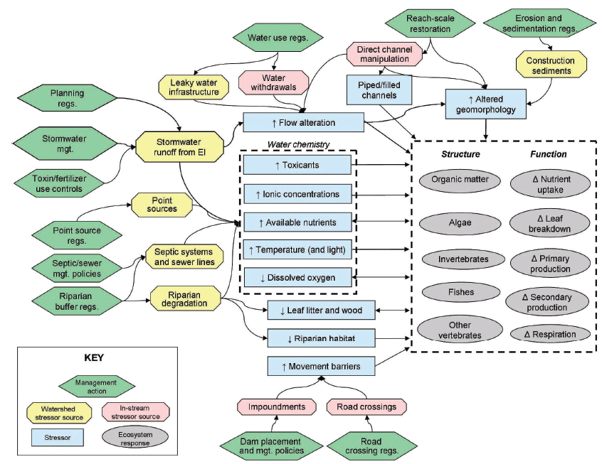
Conceptual model of urbanization effects on streams; Wenger et al. 2009

Slide 3
Framework links management decisions to stream health
Management
Stressors
Responses
Complex decisions/ desired protection
Hydrology
Pollutants
Measures of health

Slide 4
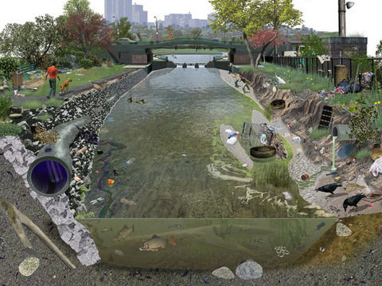
Is it a hydrology or pollutant problem?
USGS, Frank Ippolito 2010

Slide 5
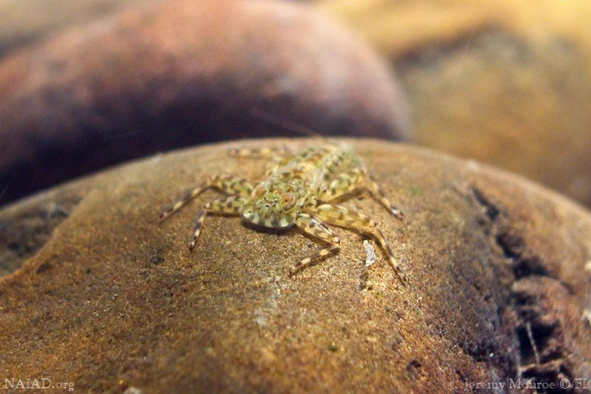
How many species and which species of ‘stream bugs’ are present? Are species sensitive to or tolerant of pollution?

Slide 6
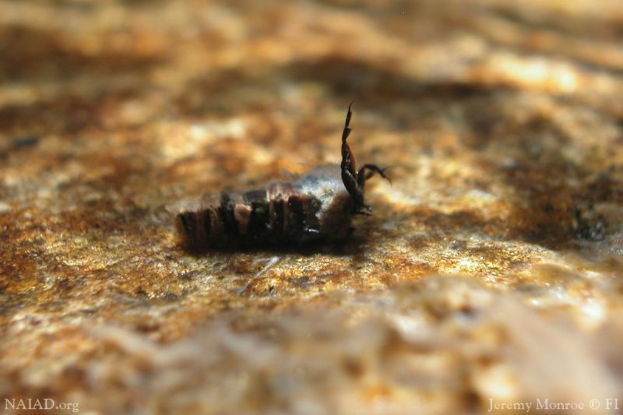
How much are present? Reduced numbers/biomass of ‘stream bugs’ may indicate effects of hydrology

Slide 7
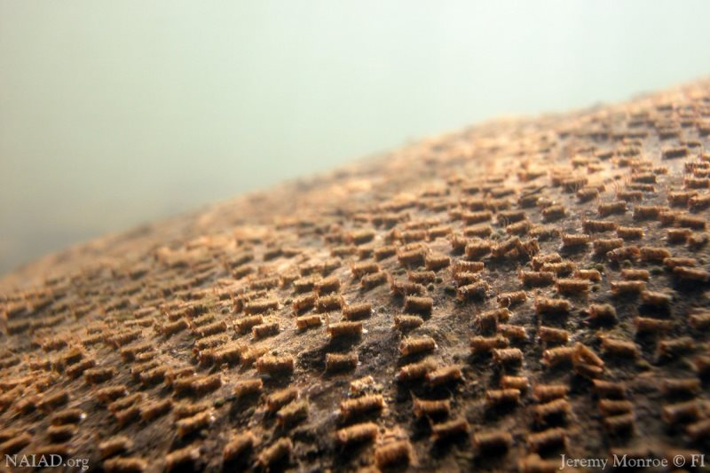
How much are present?
Lots of bugs = healthy stream

Slide 8
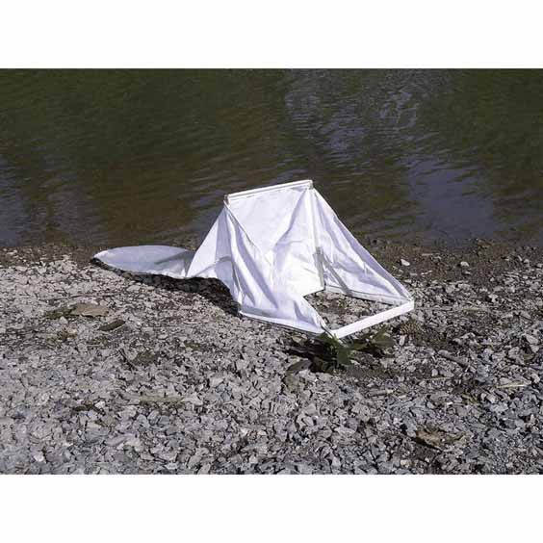
Biomass: Quantitative sampling, identify and measure all bugs present (replicate samples per stream)
This study – 32,900 invertebrates identified and measured!
Surber sampler – Wildco/Cole Parmer

Slide 9
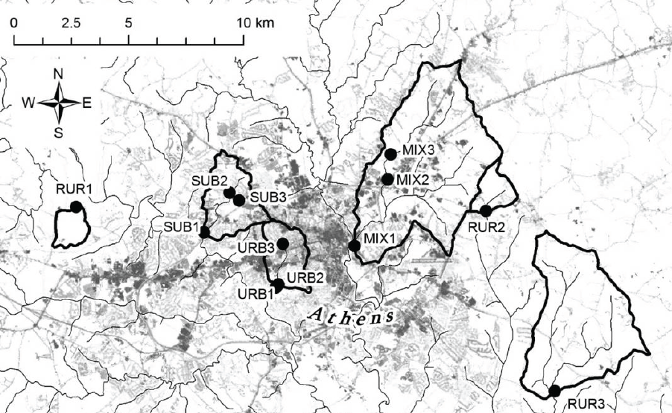
Sites sampled in this study
Increased watershed urbanization gradient: Rural, mixed use, suburban, urban
Sterling et al. 2016

Slide 10
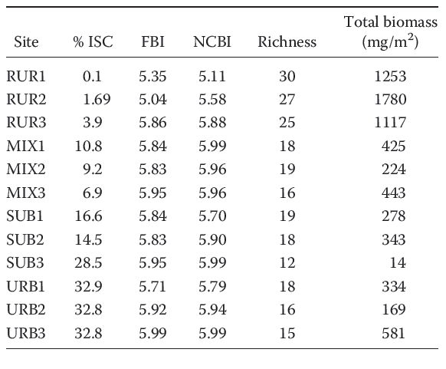
% impervious surface cover = urbanization
Number of species↓ 30 vs 15; Biotic index scores good/fair to fair/poor
Biomass ↓ high in Rural, lower in other sites
# species
Losing Biodiversity and function!
Sterling et al. 2016

Slide 11
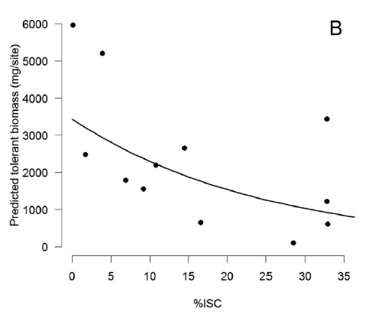
Biomass↓ of even tolerant bugs
Evidence that both pollution and hydrology are affecting ACC streams
Sterling et al. 2016

Slide 12
Good news: many management decisions can address both stressor types: slowing stormwater, promoting natural filtration, rain gardens, stream buffers, etc.
Management
Stressors
Responses
Complex decisions/ desired protection
Hydrology
Pollutants
Measures of health

Slide 13
Acknowledgements
Collaboration with Athens-Clarke County Stormwater Division – grant-writing, data, ideas
  Ryan Eaves, Jason Peek, Adam Gaufaurian
Sample collection and processing
  Reid Brown, Caitlin Ward
Ideas, experimental design, data analysis
  Mary Freeman, Marirosa Molina

